Slide 1
Hidden Markov Model in Gene Detection
By Wei Jun Tan

Slide 2
Biological Background

Slide 3
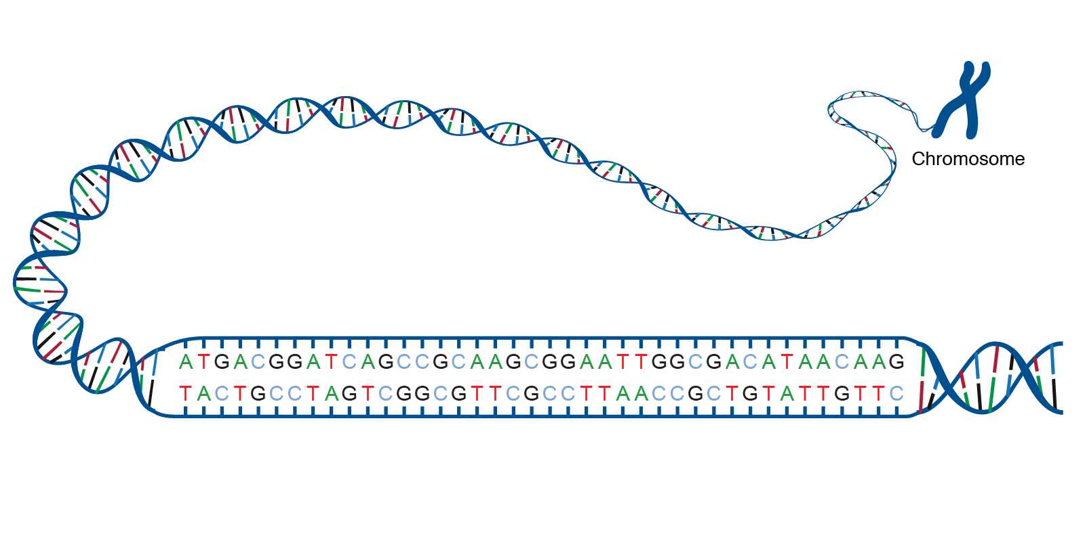
What is DNA?
A chemical compound that contains genes, which encodes protein sequence that defines the characteristics of organism
Made up of A-T-C-G

Slide 4
What is DNA?
A chemical compound that contains genes, which encodes protein sequence that defines the characteristics of organism
Gene
Non-Gene
Gene
Notes:
Motivate gene

Slide 5
Why find gene?
Improve our understanding on gene can help:
Identify mutations that cause diseases (e.g. cancer)
Cure chromosomal and genetical diseases (e.g. Down Syndrome)
…

Slide 6
Introduction to HMM

Slide 7

Hidden Markov Model (HMM)
Observation: A, T, C, G
States (Hidden): Gene, Non-Gene
Transition Probability
Emission Probability
 | Gene | Non-Gene
Gene
Non-Gene
 | A | T | C | G
Gene
Non-Gene
$$P(state_{i+1}=Gene|state_{i}=Non−Gene)$$
$$P(observe_{i}=T|state_{i}=Gene)$$

Slide 8
Viterbi
Q: Given a sequence of DNA (i.e. ATCG) and a HMM (transition and emission matrix), how do we find the gene?
A: Use Viterbi to compute the most probable path of hidden states!

Slide 9
Example
 | C | A | G | G
Gene | 0.5
Non-Gene | 0.5
$$Max(C_{Gene} to A_{Gene} , C_{Non−Gene} to A_{Gene})$$
Can be computed using transition and emission matrix!

Slide 10
Example
 | C | A | G | G
Gene | 0.5 | 0.3 | 0.15 | 0.04
Non-Gene | 0.5 | 0.2 | 0.06 | 0.02

Slide 11
Example
 | C | A | G | G
Gene | 0.5 | 0.3 | 0.15 | 0.04
Non-Gene | 0.5 | 0.2 | 0.06 | 0.02
Two Genes Found!

Slide 12
Use HMM to predict gene Given an annotated genome

Slide 13
Training
Use human chromosome 21 (3M+ long) to train our model
Count the number of transitions and emissions
Normalize the count to get the transition and emission matrix
 | Gene | Non-Gene
Gene | 0.999982 | 0.000037
Non-Gene | 0.000018 | 0.999963
 | A | T | C | G
Gene | 0.2587 | 0.2747 | 0.2354 | 0.2312
Non-Gene | 0.2871 | 0.2967 | 0.2112 | 0.2050

Slide 14
Testing
Use human chromosome 20 (64M+ long) to test our model
Use Viterbi to find the predicted path and compare with the actual states

Slide 15
Visualization
Actual Gene V.S. Predicted Gene
Training Set
* Testing Set is not shown as it is too large for readable visualization

Slide 16
Result
Testing Set
Accuracy: 0.6145
Precision: 0.6018
Recall: 0.5479
Baseline Accuracy: 0.4367
Training Set
Accuracy: 0.5575
Precision: 0.4777
Recall: 0.4015
Baseline Accuracy: 0.6646
Surprisingly, we perform better in testing set than training set!

Slide 17
Result
Testing Set
Accuracy: 0.6145
Precision: 0.6018
Recall: 0.5479
Baseline Accuracy: 0.4367
Training Set
Accuracy: 0.5575
Precision: 0.4777
Recall: 0.4015
Baseline Accuracy: 0.6646
Precision: Among all your predictions, how many of them are correct?
Recall: Among all actual genes, how many of them do you predict?

Slide 18
Result
Testing Set
Accuracy: 0.6145
Precision: 0.6018
Recall: 0.5479
Baseline Accuracy: 0.4367
Training Set
Accuracy: 0.5575
Precision: 0.4777
Recall: 0.4015
Baseline Accuracy: 0.6646
Baseline Accuracy: The accuracy of a model that always predict Non-gene (i.e. the frequency of genes)

Slide 19
Improvement
Problem: Underfitting due to strong assumption in the model
Encode more specific features (dinucleotide, codon, start codon, end codon)
Encode more specific hidden states (gene types)
Notes:
More states

Slide 20
Summary
Use a HMM to detect gene
Needs improvement
Please do SHARE your questions!

Slide 21

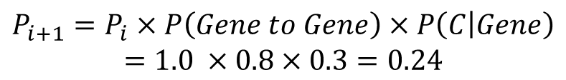



Q/A: Probability Calculation
 | Gene | Non-Gene
Gene | 0.8 | 0.1
Non-Gene | 0.2 | 0.9
$$T_{Gene}$$
$$C_{Gene}$$
$$P_{i}=1.0$$
$$P_{i+1}= ?$$
$$P_{i+1}=P_{i}×P\left(Gene to Gene\right)×P\left(C | Gene\right)=1.0 ×0.8×0.3=0.24$$
 | A | T | C | G
Gene | 0.2 | 0.2 | 0.3 | 0.3
Non-Gene | 0.3 | 0.4 | 0.2 | 0.1
Notes:
Remove this example

Slide 22
Naive: Counting
 | Gene | Non-Gene
A | 10000 | 7500
T | 10000 | 7500
C | 5000 | 7500
G | 5000 | 7500
 | Gene | Non-Gene
A | 0.33 | 0.25
T | 0.33 | 0.25
C | 0.17 | 0.25
G | 0.17 | 0.25
Given a sequence, check whether the distribution is closer to gene or non-gene…
*Assume Independence of nucleotides - unrealistic

Slide 23
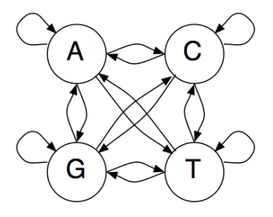
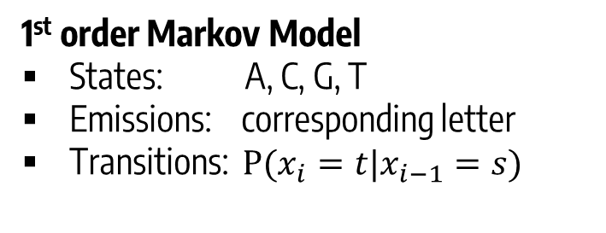
Markov Model
A sequence of random variables is a k^{th} order Markov chain if its value is dependent on the previous k values
1st order Markov Model
States: A, C, G, T
Emissions: corresponding letter
Transitions: $P(x_{i}=t|x_{i−1}=s)$

